Slide 1
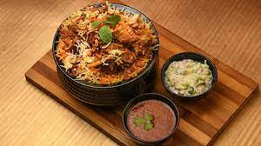

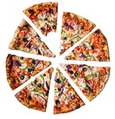

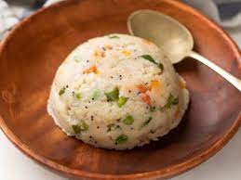
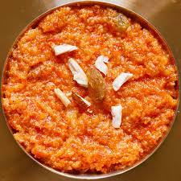
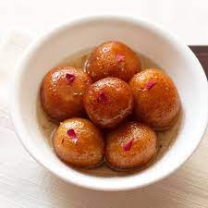

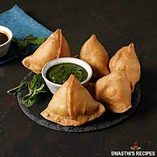



MPR GROUP-9
Project Guide :
Archana Ma’am Group Members:
~ Aarna Bafna (11)
~ Soham Amare (06)
~ Shivam Killarikar (66)
~ Shawn Dcosta (26)

Slide 2







Feedback Given
Removal of option for choosing Health Condition
Addition of Calorie Counting Feature

Slide 3
Application’s Features:
BMI Caculator
A-Z
Exercises
Calorie Counter
Meal Tracker

Slide 4
Application’s Flow
Home page that displays Dashboard and all features of the app
Choose from: BMI calculator Calorie Counter A-Z Exercise Meal Tracker
Registration
Page
(Storing of credentials)
Login
Page
Launch

Slide 5
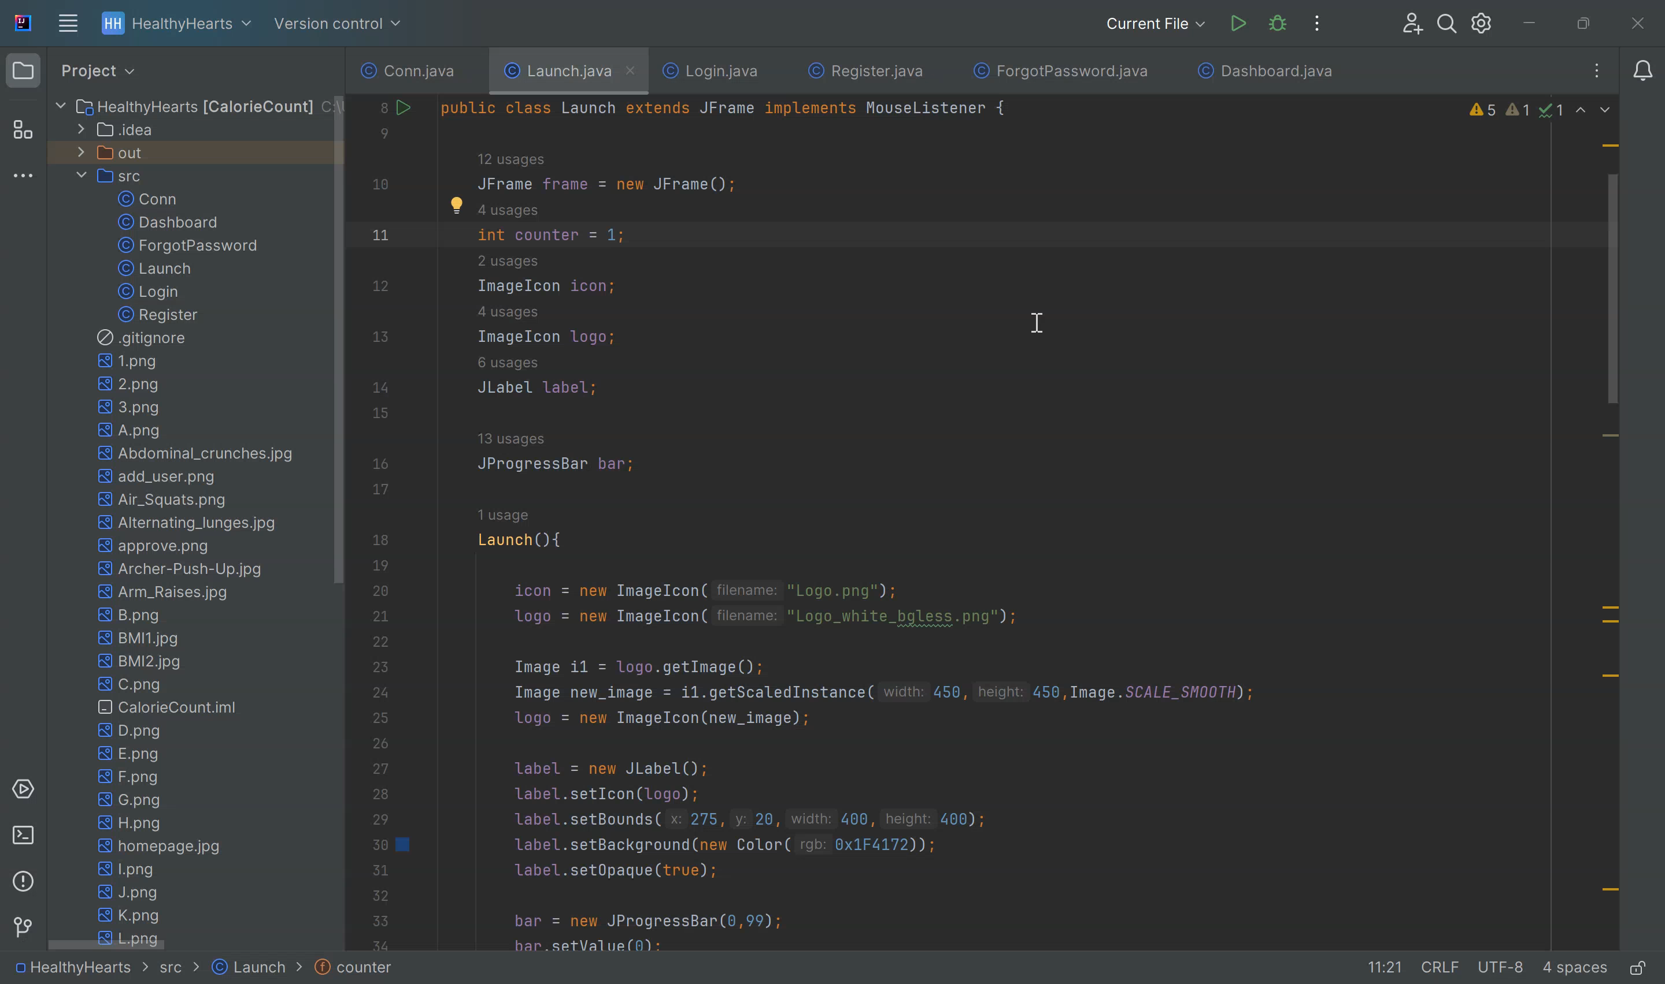

Slide 6
References
https://fdc.nal.usda.gov/fdc-app.html#/fooddetails/168013/nutrients
https://www.nutritionix.com/
https://colorhunt.co/
https://www.myfitnesspal.com/

Slide 7
Thank You!

